Slide 1

Basics
Of
networking

Slide 2
What is Network?
When two or more network devices are connected with
each other is called network.

Slide 3
What is Networking?
When two or more network devices are communicating with each other and doing some process. Ex. data sharing, device sharing, is called networking.

Slide 4
What is networker?
→
Who create the network is called networker.

Slide 5
Why N+ certified?
→
Three major benefits are associated with
becoming N+ certified.
Proof of professional achievement.
Opportunity for advancement.
Fulfillment of training requirements.

Slide 6
TYPES OF NETWORK
Lan
Man
Wan
can

Slide 7
LAN (Local area network)‏
→Any network located in a small area (in a building or a campus)
is known as Local area network.

Slide 8
MAN (Metropolitan area network)‏
→Two or more networks connected within a city, is
known as Metropolitan area network.

Slide 9
WAN (Wide area network)‏
→Two or more networks connected between cities, states or countries, is known as Wide area network.

Slide 10
Can (campus area network)
→When different lan connects of same organization is
called can.

Slide 11
NETWORK TOPOLOGIES

Slide 12
THE PHYSICAL OR LOGICAL LAY OUT OF THE TRANSMITION MEDIA SPESIFAID IN THE PHUSICAL AND LOGICAL LAYER OF AND ANY MODEL. THEY ARE FOLLOWING PHYSICAL TOPOLOGY USE IN NETWOKING :-
BUS TOPOLOGY
RING TOPOLOGY
STAR TOPOLOGY
MESH TOPOLOGY
HYBRID TOPOLOGY
POINT-TO-POINT TOPOLOGY
POINT-TO-MULTIPOINT TOPOLOGY

Slide 14
ADVANTAGES
IT IS NOT VERY EXPENSIVE IN CABLING COST
EASY TO INSTALL
DISADVANTAGES
HARD TO TROULESOOT
HARD TO CHANG OR MOVE BECAUSE EVERYTHING IS
CONNECTED THAT SINGLE CABLE

Slide 16
ADVANTAGES
NEW STATION CAN BE ADDED EASILY & QUICKLY
A SINGLE CABLE FAILUR WON’T BRING DOWN THE ENTIRE NETWORK
IT IS RELATIVELY EASY TO TROUBLESHOOT
DISADVANTAGES
THE TOTAL INSTALLATION COST CAN BE HIGHER BECAUSE OF THE LARGER NUMBER OF CABLES
IT HAS A SINGLE POINT OF FAILURE (THE HUB OR OTHER CENRAL DEVICE)

Slide 18
ADVANTAGES
IT IS NOT VERY EXPENSIVE IN CABLING COST
EASY TO INSTALL
DISADVANTAGES
HARD TO RECONFIGURE
NOT FAULT TOLERANT
HARD TO CHANG OR MOVE BECAUSE EVERYTHING IS CONNECTED THAT SINGLE CABLE

Slide 19
In This Topology You Will Find That There’s Path From Every Machine To Every Other One
In The Network.

Slide 20
Networking Devices
Equipment that connects directly to a network segment is referred to as a device.
These devices are broken up into two classifications.
end-user devices
network devices
End-user devices include computers, printers, scanners, and other devices that provide services directly to the user.
Network devices include all the devices that connect the end-user devices together to allow them to communicate.

Slide 21
NETWORK DEVICES
HUB
REPEATER
MODEM
NETWORK INTERFACE CARD (NIC)
BRIDGE
SWITCH
ROUTER

Slide 22
Networking Device Icons

Slide 23
Hub
Hubs concentrate connections. In other words, they take a group of hosts and allow the network to see them as a single unit.
This is done passively, without any other effect on the data transmission.
Active hubs not only concentrate hosts, but they also regenerate signals.

Slide 24
IT IS A PHYSICAL LAYER DEVICE (LAYER 1)
IT IS USED TO CONNECT SEVRAL COMPUERS TOGATHER
IT WORKS WITH 0’S AND 1’S (BITS)
IT WORKS WITH BRODCASTING
IT CAN BE BETWEEN USED ON THE SAME LAN AND USERS ON DIFFERENT LAN’S
IT IS OFFTEN USES IN STAR OR RING TOPOLOGY

Slide 25
Repeater
A repeater is a network device used to regenerate a signal.
Repeaters regenerate analog or digital signals distorted by transmission loss due to attenuation. A repeater does not perform intelligent routing.

Slide 26
IT IS A DEVICE THAT AMPLIFIES AND RESTORES THE POWER OF A SIGNAL BEING TRANSMITTES ON THE NETWORK
IT IS USES IN LONG NETWORK LINES
COAXIAL CABLE USES WITH REPEATER

Slide 27
MODEM
IT IS A COMPUTER PERIPHERAL THAT ALLOW YOU TO CONNECTAND COMMUNICATE WITH OTHER COMPUTER VIA TELEPHONE LINE
MODEM CHANGES THE DIGITAL DATA FROM YOU COMPUTER INTO ANALOG DATA A FORMAT THAT CAN BE CARRIED OVER TELEPHONE LINES
IN THE SAME THE MODEM RECEIVING THE CALL THEN CHANGES THE ANALOG SIGNAL BACK INTO DIGITAL DATA THAT THE COMPUTER CAN UNDRSTAND

Slide 28
Network Interface Card
A network interface card (NIC) is a printed circuit board that provides network communication capabilities to and from a personal computer. Also called a LAN adapter.

Slide 29
TYPE OF LAN CARD DEVELOPED BY XEROX CARP ALONG WITH DEC AND INTEL
IT USES A BUS OR STAR TOPOLOGY
SUPPORT DATA TRANSFER RATES OF UPTO 10 MBPS

Slide 30
Bridge
Bridges convert network transmission data formats as well as perform basic data transmission management. Bridges, as the name implies, provide connections between LANs. Not only do bridges connect LANs, but they also perform a check on the data to determine whether it should cross the bridge or not. This makes each part of the network more efficient.

Slide 31
IT IS A DEVICE THAT LETS YOU LINK TWOSAME NETWORK TOGETHER
SAME NETWORK MEAN NETWORK WITH SAME PROTOCOL

Slide 32
Workgroup Switch
Workgroup switches add more intelligence to data transfer management.
Switches can determine whether data should remain on a LAN or not, and they can transfer the data to the connection that needs that data.

Slide 33
SWITCH
SWITCH CONNECT MULTIPLE SEGMENTS OF A NETWORK TOGATHER MUCH HUB DO, BUT WITH THREE SIGNIFICANT DIFFERENT – A SWITCH RECOGNIZES FRAMS AND PAYS ATTENTION TO THE SOURCE AND DESTINATION MAC ADDRESS OF THE INCOMING FRAME AS WELL AS THE PAST ON WHICH IT WAS RECEIVED.HUBS DON’T DO THOSE THINGS.THEY SIMPLY SEND OUT ANYTHING THEY RECEIVE ON ONE PORT OUT TO ALL THE OTHERS.
IT IS DETALINK LAYER DEVICE (LAYER 2).
ITS IN AN INTELLIGENT DEVICE.
IT WORKS WITH FLOODING AND UNICAST & MAC ADDRESS.
IT WORKS WITH FIXED BANDWIDTH.

Slide 34
Router
Routers have all capabilities of the previous devices. Routers can regenerate signals, concentrate multiple connections, convert data transmission formats, and manage data transfers. They can also connect to a WAN, which allows them to connect LANs that are separated by great distances.

Slide 36
A ROUTER IS A COMPUTER WHOSE SOFTWARE AND HARDWARE ARE USUALLY TAILARED TO THE TASKS OF ROUTING AND FORWARDING.
THIS DEVICE ROUTERS THE INFORMATION PACKET BETWEEN TWO OR MORE PHYSCIALLY OR LOGICALLY CONNECTED NETWORKS.
IT IS DIFFERENT FROM BRIDGE AS THIS USES LOGICAL ADDRESS (IP ADDRESS) WHILE BRIDGE USES PHYSICAL ADDRESS (MAC ADDRESS).

Slide 37
“The Cloud”
The cloud is used in diagrams to represent where the connection to the internet is.
It also represents all of the devices on the internet.

Slide 38
PHYSICAL MEDIA
Cable Are More Reliable & Generally Provide Faster Transmission Speed. There Are Three Primary Type
Of Cable Used Build Lan.
Coaxial Cable
Twisted-pair Cable
Fiber Optic Cable

Slide 39
PHYSICAL MEDIA
WAIRED
WIRELESS
BLUETOOTH
INFRARED
ROUTER
COAXIAL
TWISTED
F.O.C.
THIKNET
THINNET
UTP
STP
CAT-1
CAT-2
CAT-3
CAT-4
CAT-5
CAT-5E
CAT-6
SINGLE
MODE
MULTI
MODE

Slide 46
OSI LAYERS

Slide 47
OSI Model
OSI means Open System Interconnect model.
Developed by the International Organization for Standardization in 1974.
It consists of seven layers.
Each layer has a different but specific processing function.

Slide 48
OSI Model Layers
Layer - 7
Application
Advice
Upper Layer
or
Software Layer
Layer - 6
Presentation
Person
Layer - 5
Session
Sales
Transport
Take
Layer - 4
Heart of OSI
Layer - 3
Network
Not
Lower Layer
or
Hardware Layer
Layer - 2
Data Link
Do
Layer - 1
Physical
Please

Slide 49
Application Layer
Application
Application
Application Layer is responsible for providing Networking Services to user. It also known as Desktop Layer. Identification of Services is done using Port Numbers.
Ports are nothing but Socket i.e. Entry and Exit Point to the Layer
Total No. Ports 0 – 65535
Reserved Ports 0 – 1023
Open Ports 1024 – 65535
Presentation
Session
Transport
Network
Data Link
Physical

Slide 50
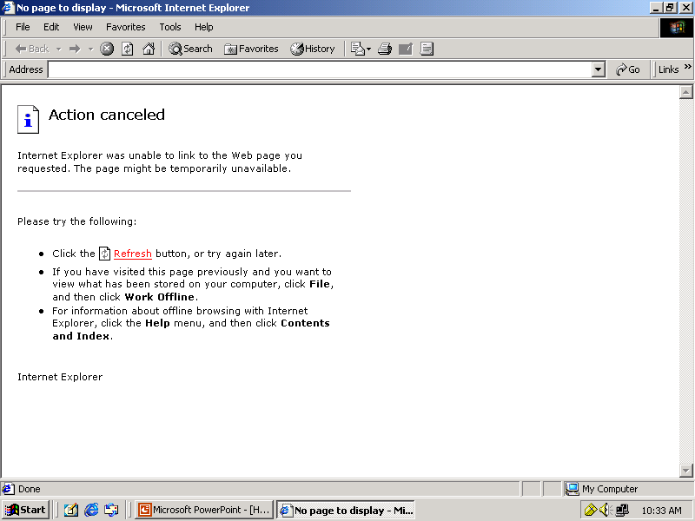
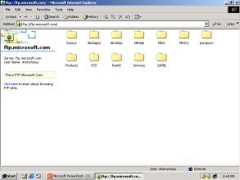
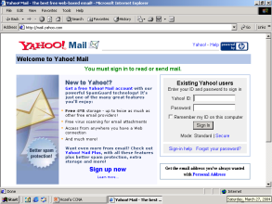
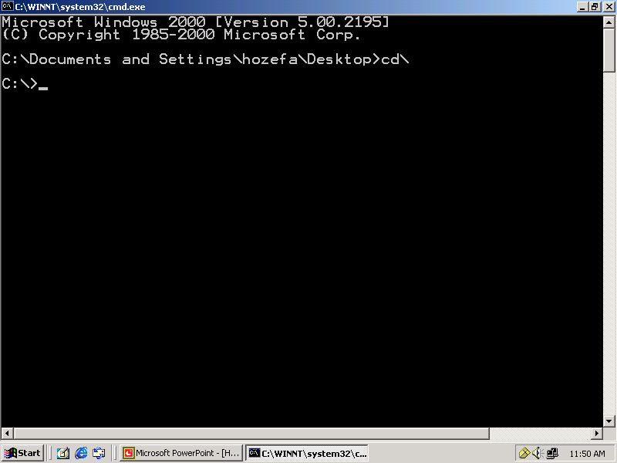
Examples of Networking Services
Service Port No.
HTTP 80
FTP 21
SMTP 25
TELNET 23
TFTP 69

Slide 51
How data flows from Application Layer
Application
Data
80
21
25
53
67
69
Presentation
Session
Transport
Network
Data Link
Physical

Slide 52
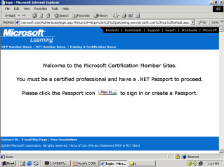
Presentation Layer
Application
Presentation Layer is responsible for converting data into standard format.
Examples : ASCII, EBCDIC, JPEG, MPEG, BMP, MIDI, WAV, MP3
Following tasks are perform at Presentation layer :
Encoding – Decoding
Encryption – Decryption
Compression – Decompression
Presentation
Presentation
Session
Transport
Network
Data Link
Physical

Slide 53
How data flows from Presentation Layer
Application
Data
Presentation
Data
Session
Transport
Network
Data Link
Physical

Slide 54
Session Layer
Application
Session Layer is responsible establishing, maintaining and terminating session.
Session ID also works at Session Layer.
Examples :
RPC → Remote Procedure Call
SQL → Structured Query language
NFS → Network File System
Presentation
Session
Session
Transport
Network
Data Link
Physical

Slide 55
How data flows from Session Layer
Application
Data
Presentation
Data
Session
Data
Transport
Network
Data Link
Physical

Slide 56
Transport Layer
Application
Transport Layer is responsible for end-to-end connectivity. It is also known as heart of OSI Layers. Following task are performed at Transport Layer : -
Identifying Service
Multiplexing & De-multiplexing
Segmentation
Sequencing & Reassembling
Flow Control
Error Correction
Presentation
Session
Transport
Transport
Network
Data Link
Physical

Slide 57
Identifying Service
TCP
UDP
Transmission Control Protocol
Connection Oriented
Acknowledgement
Reliable
Slower
Port No. 6
e.g. HTTP, FTP, SMTP
User Datagram Protocol
Connection Less
No Acknowledgement
Unreliable
Faster
Port No. 17
e.g. DNS, DHCP, TFTP

Slide 58
Multiplexing & De-multiplexing
Application
Presentation
Session
80
21
25
53
67
69
Transport
TCP - 6
UDP - 17
Network
Data Link
Physical

Slide 59
Segmentation
Hello! How are you ?
Hello! How are you ?
Hello!
How
Are
You
?
A
B

Slide 60
Sequencing & Reassembling
Hello! How are you ?
you Hello! How ? are
Hello! How are you ?
You Hello! How ? Are
You
Hello!
How
?
Are
Hello!
How
Are
You
?
A
B

Slide 61
Sequencing & Reassembling
Hello! How are you ?
Hello! How are you ?
Hello! How are you ?
Hello! How are you ?
Hello!
1/5
Hello!
1/5
Are
3/5
Are
3/5
You
4/5
You
4/5
?
5/5
How
2/5
?
5/5
How
2/5
You
4/5
Hello!
1/5
How
2/5
?
5/5
Are
3/5
A
B

Slide 62
Error Correction
Hello! How are you ?
Segment Missing
Hello! How are you ?
Hello! How are you ?
Hello! How are you ?
Hello!
1/5
Hello!
1/5
Are
3/5
Are
3/5
You
4/5
You
4/5
?
5/5
Hello!
1/5
How
2/5
Are
3/5
You
4/5
?
5/5
How
2/5
?
5/5
You
4/5
Hello!
1/5
How
2/5
?
5/5
Are
3/5
A
B

Slide 63
Flow Control - Windowing
Sending 3-window
PC-A
can send 4 Segment at a time to
PC-B
Received 3-window
Ack. Received-4
Ack-Rec-3
Sending
5-window
Received 4-window
A
B

Slide 64
How data flows from Transport Layer
Application
Data
Presentation
Data
Session
Data
Transport
Segment
TH
Data
Network
Data Link
Physical

Slide 65
Network Layer
Application
Network Layer is responsible for providing best path to data to reach destination. Logical Addressing sits on this layer. Device working on Network Layer is Router.
It is divided into two parts
Routed Protocols
e.g. IP, IPX, Apple Talk.
Routing Protocols
e.g. RIP, IGRP, OSPF, EIGRP
Presentation
Session
Transport
Network
Network
Data Link
Physical

Slide 66
Routed Protocols
Segment
Segment
Hello! How are you ?
Hello! How are you ?
Source IP
192.168.1.1
Destination IP
192.168.1.2
Source IP
192.168.1.1
Destination IP
192.168.1.2
Segment
A
B
192.168.1.1
192.168.1.2

Slide 67
Routing Protocols
www.iantindia.com
A

Slide 68
How data flows from Network Layer
Application
Data
Presentation
Data
Session
Data
Transport
Segment
e.g. Router
Network
Packet
NH
Segment
Data Link
Physical

Slide 69
Datalink Layer
Application
Datalink Layer is divided into two Sub Layers :
LLC – Logical Link Control
It talks about Wan protocols e.g. PPP, HDLC, Frame-relay
MAC – Media Access Control
It talks about Physical Address. It is 48 bit Addressing i.e. 12 digit Hexadecimal No. It is also responsible for Error Detection
Device working on Data Link Layer is Switch, Bridge, NIC.
Presentation
Session
Transport
Network
Data Link
Data Link
Physical

Slide 70
Error Detection – CRC Check
PC-A
CRC No. 33333
PC-B
CRC No. 11114
Error Detected
For Error Correction
Contact Source Transport layer
Packet
Hello! How are you ?
Source MAC
00-20-18-C0-07-71
Destination MAC
00-20-18-C0-07-72
00000
32434
22222
89696
55434
99323
43434
99434
46323
11114
33333
00000
32434
22222
89696
55434
99323
43434
99434
46323
11114
Error Detected
Packet
A
B
192.168.1.1
00-20-18-C0-07-71
192.168.1.2
00-20-18-C0-07-72

Slide 71
Error Detection – CRC Check
Packet
Packet
Hello! How are you ?
Source MAC
00-20-18-C0-07-71
Destination MAC
00-20-18-C0-07-72
00000
32434
22222
89696
55434
99323
43434
99434
46323
11114
20202
00000
32434
22222
89696
55434
99323
43434
99434
46323
11114
20202
Source MAC
00-20-18-C0-07-71
Destination MAC
00-20-18-C0-07-72
Packet
A
B
192.168.1.1
00-20-18-C0-07-71
192.168.1.2
00-20-18-C0-07-72

Slide 72
How data flows from Data Link Layer
Application
Data
Presentation
Data
Session
Data
Transport
Segment
e.g. Switch
Network
Packet
Data Link
Frame
DH
Packet
Packet
DT
Physical

Slide 73
Physical Layer
Application
Physical Layer is responsible for electrical, mechanical or procedural checks. Data will be converted in Binary that is 0’s & 1’s. Data will be in the form of electrical pulses if it is Coaxial or Twisted Pair cable and in the form of Light if it is Fiber Optic Cable.
Devices working at Physical Layer are Hubs, Repeaters, Cables, Modems etc.
Presentation
Session
Transport
Network
Data Link
Physical
Physical

Slide 74
Physical Layer Example
Frame
Frame
Hello! How are you ?
1010101010101010
1010101010101010
Frame
A
1010101101010101010101010
B
0101011010101010101010101
1010101101010101010101010
0101011010101010101010101
0101011010101010101010101

Slide 75
How data flows from Physical Layer
Application
Data
Presentation
Data
Session
Data
Transport
Segment
Network
Packet
Data Link
Frame
e.g. Hub
Physical
Bits

Slide 76
Data Encapsulation & De-capsulation
A
B
Application
Data
Data
Application
Presentation
Data
Data
Presentation
Session
Data
Data
Session
Transport
Transport
Segment
Segment
TH
TH
Data
TH
Data
Network
Packet
Packet
Network
NH
Segment
NH
Segment
NH
Data Link
Packet
Data Link
Frame
DH
Frame
DH
Packet
Packet
Packet
DT
DT
DH
DT
Physical
Bits
Bits
Physical

Slide 77
Comparing OSI with TCP/IP Layers
OSI Layers
TCP/IP Layers
Application
Application
Presentation
Session
Transport
Transport
Network
Internet
Data Link
Network
Access
Physical

Slide 79
Based on MSD , the IP addresses are classified into various classes
MSD = 8 bits , the range is from 00000000 - 11111111
Priority Bit
Range
Class A
0
00000000 - 01111111
0 – 127
Class B
10
10000000 – 10111111
128 – 191
Class C
110
11000000 – 11011111
192 – 223
Class D
1110
11100000 - 11101111
224 – 239
Class E
1111
11110000 - 11111111
240 - 255

Slide 80
→Each address will have network id and host id in it.
→Network id is to identify the network in which the system is located.
→Host id is to identify the system in the network.
→Subnet Mask is used to Differentiating the Classes
Network & Host IDs
Subnet Mask
Class A
N.H.H.H
255.0.0.0
Large networks
Class B
N.N.H.H
255.255.0.0
Medium networks
Class C
N.N.N.H
255.255.255.0
Small networks
Class D
-
-
Multicast communication
Class E
-
-
R & D

Slide 81
LAN Setup:
Cross Cable (Cat 5 UTP)‏
IP Address : 192.168.10.5
Subnet Mask : 255.255.255.0
IP Address : 192.168.10.6
Subnet Mask : 255.255.255.0

